Slide 1



Affective Dependency Graph for Sarcasm Detection
SIGIR-2021
https://github.com/HLT-HITSZ/ADGCN
Reported by Nengqiang Xiang

Slide 2
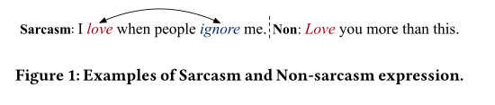
Introduction
the long range literal sentiment inconsistencies.
Explored an affective graph and a dependency graph for each sentence based on the affective information retrieved from external affective commonsense knowledge(SenticNet).
Proposed an Affective Dependency Graph Convolutional Network (ADGCN) framework.

Slide 3
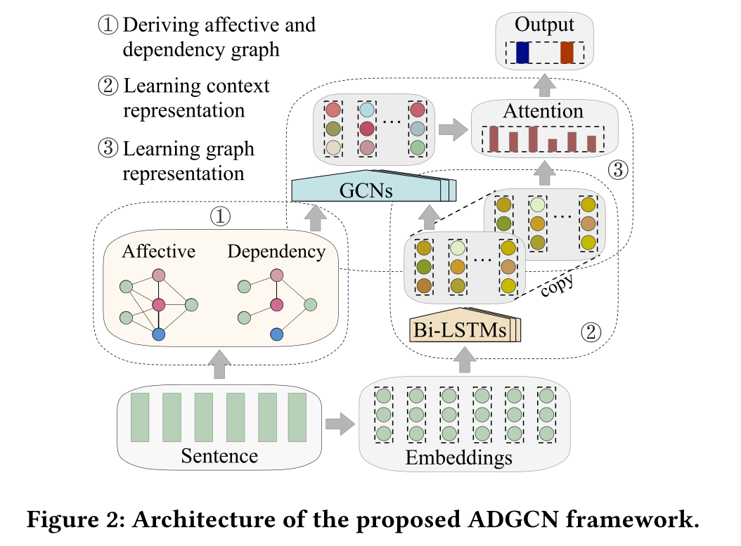
Method

Slide 4
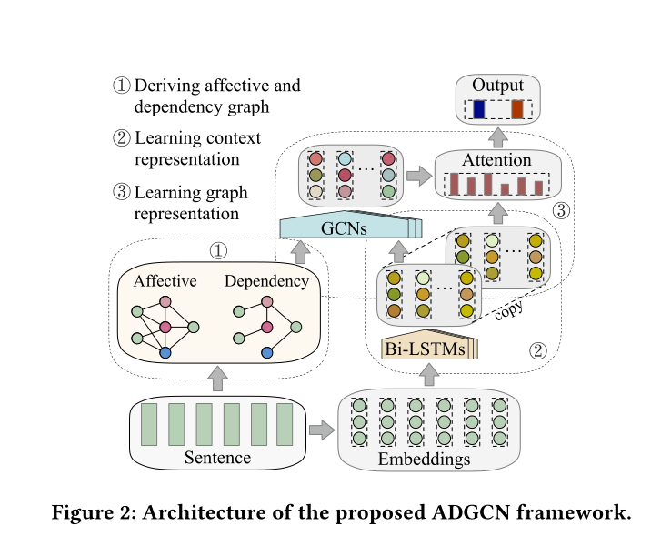




Method
①Deriving Affective and Dependency Graphs
（1）
（2）

Slide 5
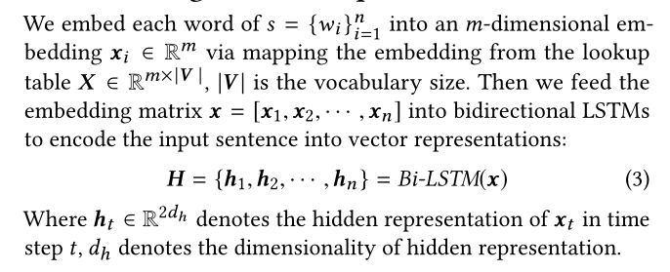
Method
②Learning Context Representation

Slide 6



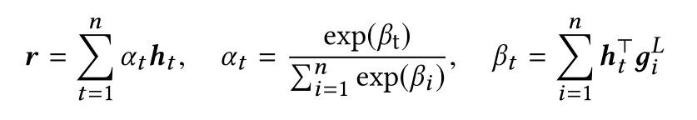


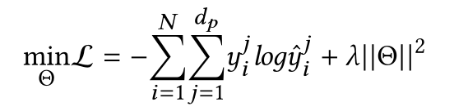
Method
③Learning Graph Representation
（4）
（5）
（6）
（7）

Slide 7
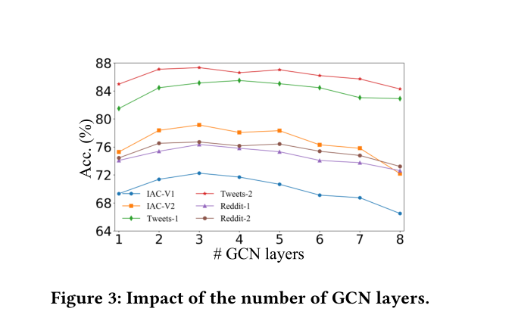
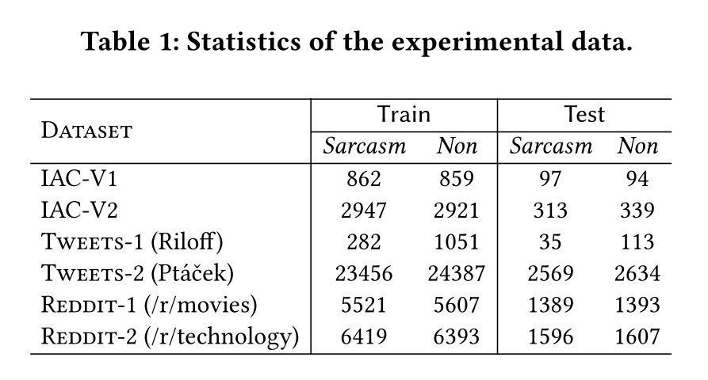
Experiments

Slide 8
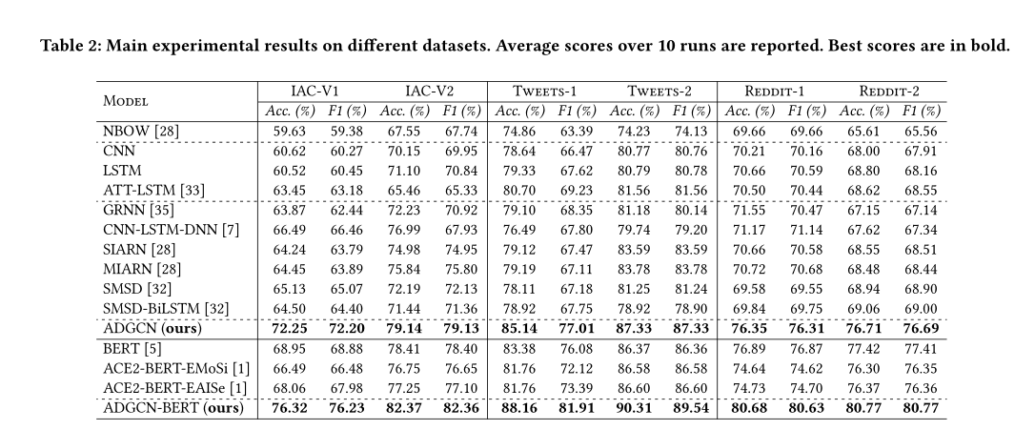
Experiments

Slide 9
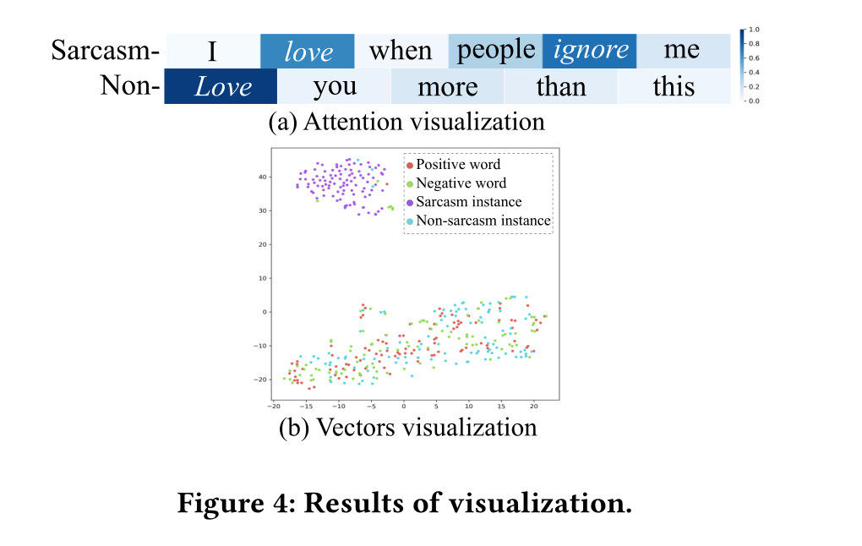
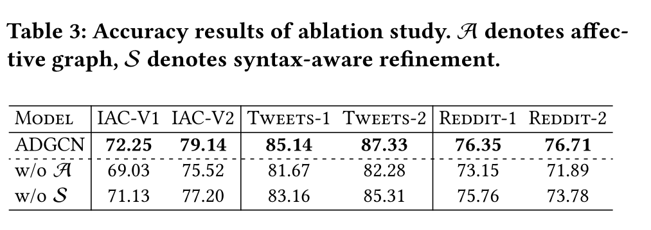
Experiments

Slide 10
Thanks

